Slide 1

Implementing
SECURITY & CRIME SCIENCE
Hotspot Policing

Slide 2
Source: J Ratcliffe. Reducing Crime: a companion for police leaders. p 194.

Slide 3
How much hotspot policing is enough?

Slide 4
“The greatest deterrent effect may be produced not by police staying in the same hot spot for extended periods, but by police roving from hot spot to hot spot, staying in each for only a limited time.”
Source: L Sherman & D Weisburd. 1995. General deterrent effects of police patrol in crime “hot spots”: A randomized, controlled trial. Justice Quarterly 12(4):625–648.

Slide 5
Getting out of the car
“[C]alled it Park and Walk. Put yourself out, then go to that area, and you walked around. And you did that for anywhere from twenty minutes, forty minutes, an hour, whatever … you just had to … park and walk”
Source: C Haberman & W Stiver. 2019. Using officers’ perspectives to guide the implementation of hot spots foot patrols. Policing and Society (advanced online).

Slide 6
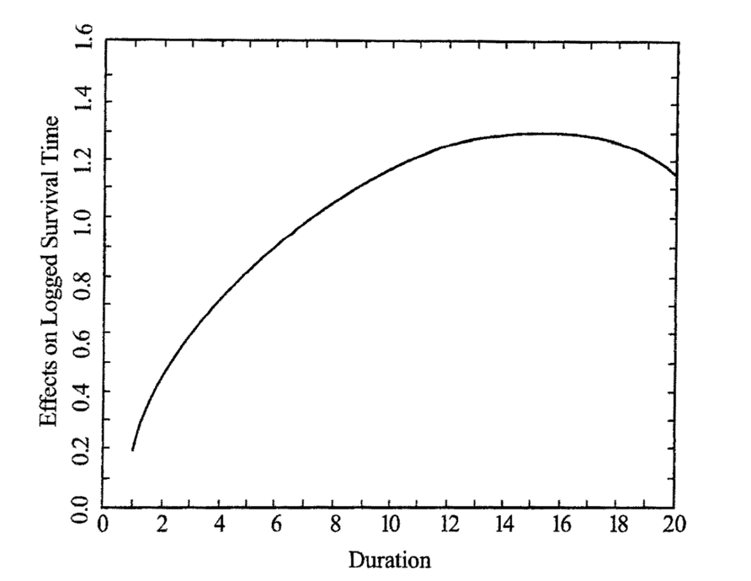
‘Koper curve’
too short, less effect
too long, wasted effort
Source: C Koper. 1995. Just enough police presence: Reducing crime and disorderly behavior by optimizing patrol time in crime hot spots. Justice Quarterly 12(4)649-672.

Slide 7
Fewer 10-minute patrols better than more 5-minute patrols
“the difference between 2.5 longer [9.6 minute] visits and 5 shorter [5.2 minute] visits causes about 20% less crime when longer visits are delivered”
Source: S Williams & T Coupe. 2017. Frequency Vs. Length of Hot Spots Patrols: a Randomised Controlled Trial. Cambridge Journal of Evidence-Based Policing 1(1):5–21.

Slide 8
“The optimal length of a hot spot patrol appears to be about 12 minutes. This should be well within the police boredom threshold, allowing them to move on to the next hot spot to see who might be causing trouble upon their arrival.”
Source: L Sherman & D Weisburd. 1995. General deterrent effects of police patrol in crime “hot spots”: A randomized, controlled trial. Justice Quarterly 12(4):625–648.

Slide 9
Hotspot patrols can be done by civilian staff
“[patrols by PCSOs] with few arrest powers and no weapons [conducting] approximately two more ten-minute visits per day in treatment than in control [led to] 39% less crime … compared to control conditions, and 20% reductions in emergency calls-for-service”
Source: B Ariel, C Weinborn & L Sherman. 2016. “Soft” policing at hot spots—do police community support officers work? A randomized controlled trial. Journal of Experimental Criminology 12(3):277–317.

Slide 10
How will officers behave at hotspots?

Slide 11
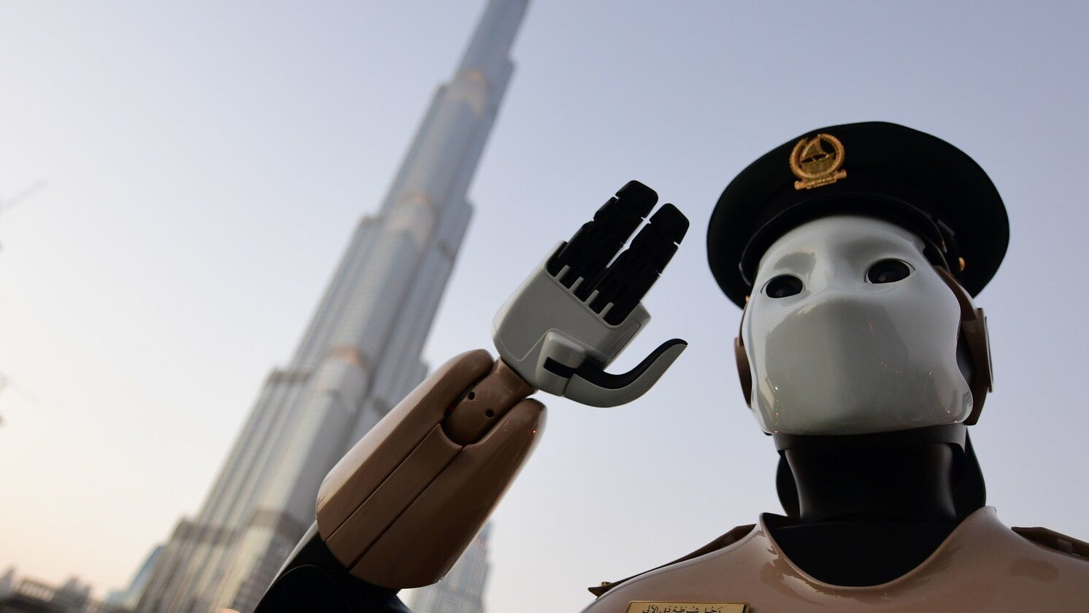
Police are not robots

Slide 12
Police officers can be agents of implementation failure
“we do that anyway”
“I’m not doing that”
“it’s not working – I’ll stop doing it”
“it makes me uncomfortable”
“I’m too busy”
“do you think I’m stupid?”
Source: S MacQueen & B Bradford. 2017. Where did it all go wrong? Implementation failure—and more—in a field experiment of procedural justice policing. Journal of Experimental Criminology 13(3):321–345.

Slide 13
Different officers (and chiefs) prefer different tactics
Warriors fighting crime and criminals
Guardians working with the public to reduce crime
Source: K McLean, S Wolfe, J Rojek, G Alpert & M Smith. 2019. Police Officers as Warriors or Guardians: Empirical Reality or Intriguing Rhetoric? Justice Quarterly (advanced online access).

Slide 14
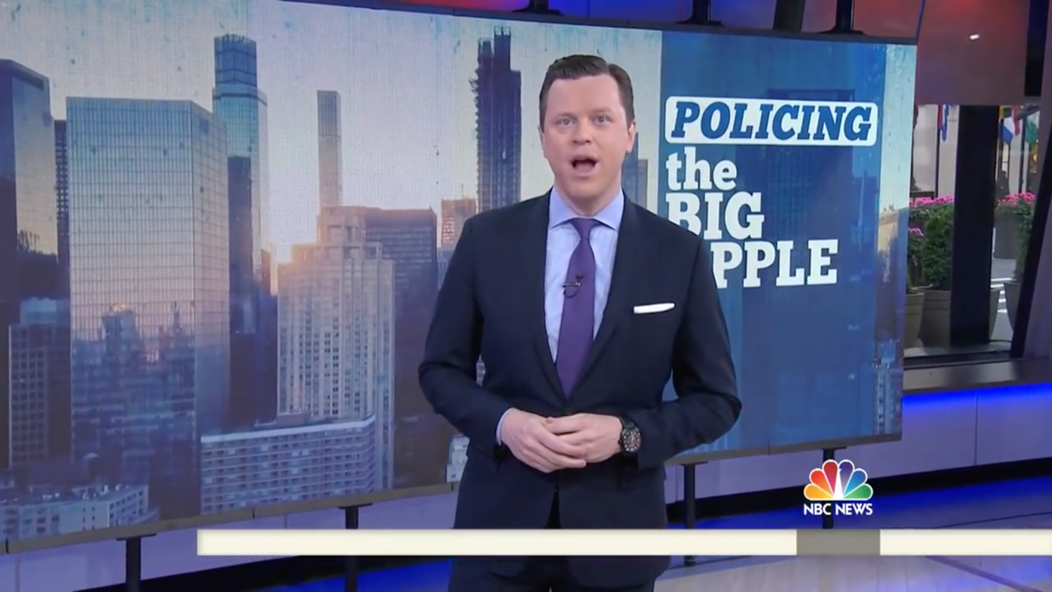

Slide 15
Hotspot patrol can change officers’ understanding of communities
“officers responded that they gained an understanding of ‘good’ people's problems, giving them a different vantage point from officers who had never walked the beat”
Source: J Wood, E Sorg, E Groff, J Ratcliffe & C Taylor. 2014. Cops as treatment providers: realities and ironies of police work in a foot patrol experiment. Policing and Society 24(3):362–379.

Slide 16
Hotspot patrol can change officers’ understanding of communities
“‘[police] were surprised at how the residents rarely had crime concerns, but were more interested in resolving quality of life issues (the trash, nuisance neighbours, and unruly youths) ’”
Source: J Wood, E Sorg, E Groff, J Ratcliffe & C Taylor. 2014. Cops as treatment providers: realities and ironies of police work in a foot patrol experiment. Policing and Society 24(3):362–379.

Slide 17
Local knowledge can change officers’ choice of tactics
“[the] decision to give [a man drinking in public] a free pass … was driven in large part by the fact that he was a known resident … had he been an outsider, [the officers] stated, he would have been brought in”
Source: J Wood, E Sorg, E Groff, J Ratcliffe & C Taylor. 2014. Cops as treatment providers: realities and ironies of police work in a foot patrol experiment. Policing and Society 24(3):362–379.

Slide 18
Officers may stray from hotspots
“all [officers] reported patrolling at locations outside [the] foot beats that they were initially assigned to patrol”
Source: E Sorg, J Wood, E Groff & J Ratcliffe. 2014. Boundary Adherence during Place-based Policing Evaluations: A Research Note. Journal of Research in Crime and Delinquency 51(3):377–393.

Slide 19
How might officers react to hotspot policing?

Slide 20
Most hotspot policing studies have not asked officers anything about it
↓
We know less about what officers think

Slide 21
Officers generally like foot patrol
“I think that’s how you get to know people. When people see you’re out walking, they’re more likely to come up and talk to you than when you’re driving by in the car”
Source: C Haberman & W Stiver. 2019. Using officers’ perspectives to guide the implementation of hot spots foot patrols. Policing and Society (advanced online).

Slide 22
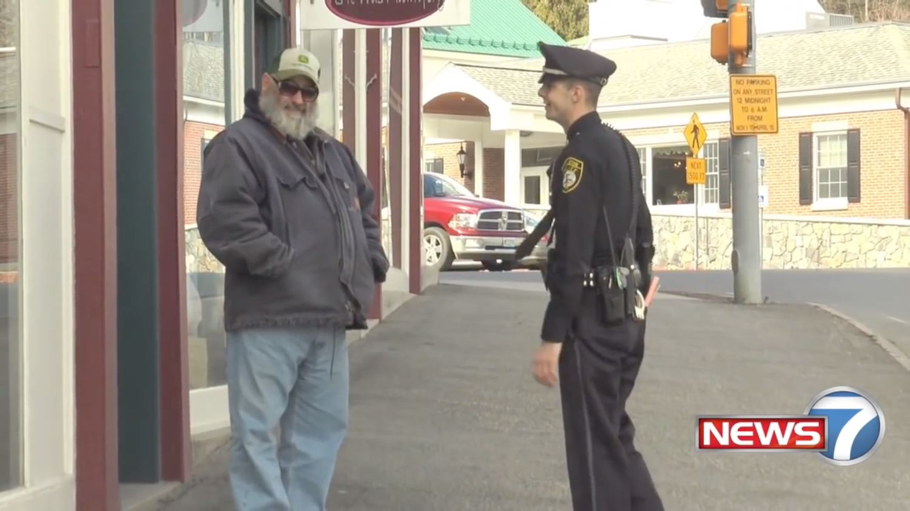

Slide 23
Officers think hotspot foot patrol increases intelligence gathering
“‘[People will] voice their concerns that they normally don’t want to call in and have an officer respond to … ’
‘[Y]ou get to really know who belongs, who doesn’t belong … the people that live and, or, work in that area, and the people that … are potentially causing crime in that area … ’”
Source: C Haberman & W Stiver. 2019. Using officers’ perspectives to guide the implementation of hot spots foot patrols. Policing and Society (advanced online).

Slide 24
Common officer concerns about hotspot patrols
Resource intensive
Unfair workload distribution
Longer response times
Officer safety
Physical demands
Equipment inaccessible
Boredom
Displacement of crime
Bad weather
Source: C Haberman & W Stiver. 2019. Using officers’ perspectives to guide the implementation of hot spots foot patrols. Policing and Society (advanced online).

Slide 25
Police officers may not like rigid hotspot patrols
Officers assigned to hotspots were …
… less likely to say hotspot patrols are useful
… less likely to believe hotspot policing effective
… more likely to say hotspot patrols restrict discretion
… even though the hotspot patrols reduced crime
Source: N Wain, B Ariel & J Tankebe. The collateral consequences of GPS-LED supervision in hot spots policing. Police Practice and Research 18(4):376–390.

Slide 26
Police officers may not like rigid hotspot patrols
“officers … clearly dislike the routinization of their shifts through the use of the 15-min patrols and feel very strongly that this removes their discretion and initiative”
Source: N Wain, B Ariel & J Tankebe. The collateral consequences of GPS-LED supervision in hot spots policing. Police Practice and Research 18(4):376–390.

Slide 27
Dislike may not decrease commitment
Officers assigned to hotspots were …
… not more likely to report lower enjoyment of policing
… not more likely to report lower enthusiasm for the job
Source: N Wain, B Ariel & J Tankebe. The collateral consequences of GPS-LED supervision in hot spots policing. Police Practice and Research 18(4):376–390.

Slide 28
But officers may become apathetic over time
“[officers] took no police action [on patrol] and made little contact with the residents. They said that they were sick of seeing and dealing with the same … At first they thought it was valuable [but now] they said it's annoying to be dealing with the same problems on a daily basis”
Source: J Wood, E Sorg, E Groff, J Ratcliffe & C Taylor. 2014. Cops as treatment providers: realities and ironies of police work in a foot patrol experiment. Policing and Society 24(3):362–379.

Slide 29
Officers may prefer “real police work”
“They [the officers] expressed that they were really sick of working foot beats … ‘They're boring as hell.’ I asked what they would rather be doing … and they stated that they wanted to be put into regular patrol squads and patrol in cars.”
Source: J Wood, E Sorg, E Groff, J Ratcliffe & C Taylor. 2014. Cops as treatment providers: realities and ironies of police work in a foot patrol experiment. Policing and Society 24(3):362–379.

Slide 30
Officers and communities may want different things
“[hotspots patrols are] good for the community but can be boring for the police. Rather than preventing crime by keeping hot spots cool, most police would prefer to catch criminals after crime has already occurred and the harm has been done. Prevention lacks glamour”
Source: L Sherman & D Weisburd. 1995. General deterrent effects of police patrol in crime “hot spots”: A randomized, controlled trial. Justice Quarterly 12(4):625–648.

Slide 31
Implementing
SECURITY & CRIME SCIENCE
Hotspot Policing

